Slide 1

Train Ticket Reservation
Project by:
Amit Kumar
Prachi Diwakar
Sofia Roman
Shetti Ashok Kumar

Slide 2
ROLES
Sofia Roman : Train Module, UI (Front Page)
Amit Kumar : Back-end(My SQL), Ticket Module
Prachi Diwakar : UI (Ticket Page), Main Module
Shetti Ashok Kumar : Passenger Module, Train_DAO Module

Slide 3

Technologies used
Spring MVC
MySQL
Java
HTML
CSS
Java Script

Slide 4
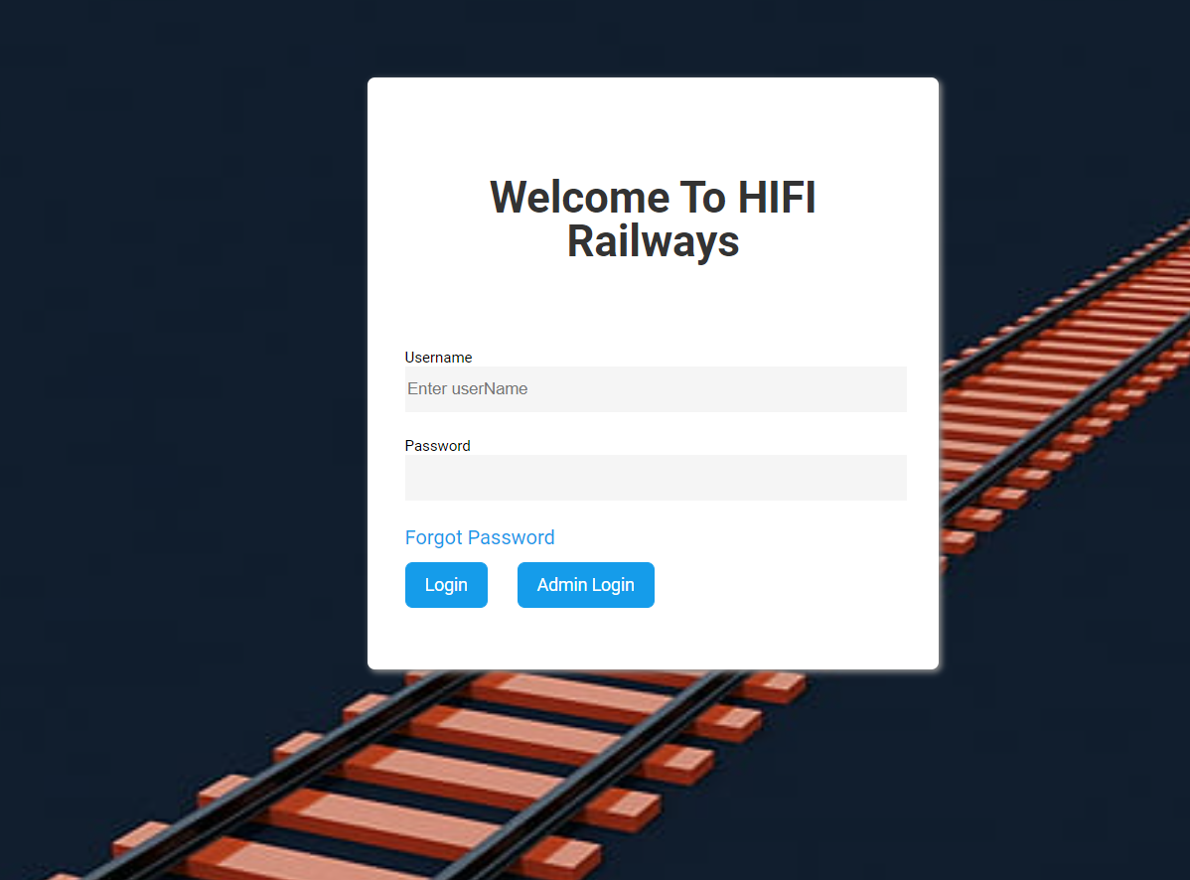
SCREENSHOTS

Slide 5
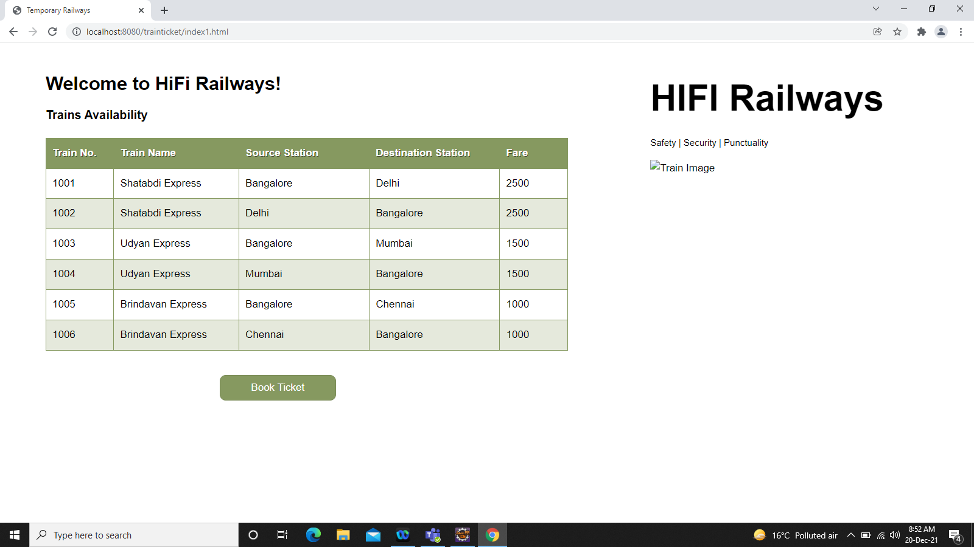

Slide 6
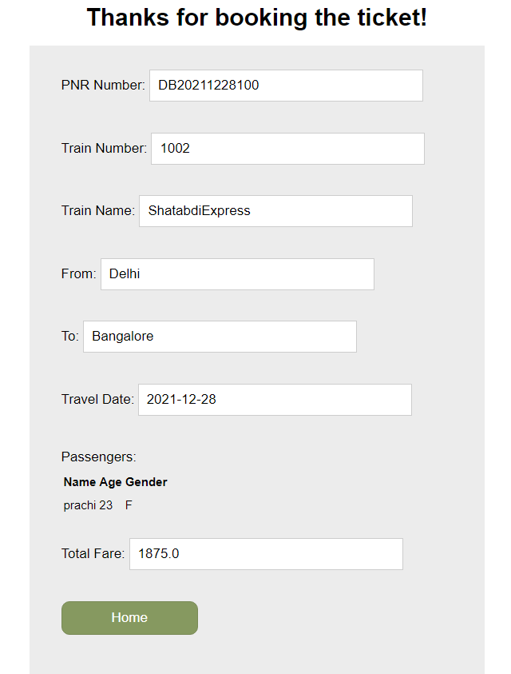

Slide 7

THANK YOU

